Slide 1
PREPAREU
Disaster Preparedness Education
for Individuals
Presented by: Calvin Oglesby
Notes:
“Hi, I’m __________ from the Red Cross and I’m here to talk to you about Disaster Preparedness.”
Note to presenters:
Presenters can proceed directly to the next slide, or
Take a few moments for a true/ false quiz (questions are included at the end of this manual),
For each statement, ask for a show of hands who thinks it’s true and who thinks it’s false. For each, give a short answer (true or false). Discussion about “why” will follow in the presentation. Determine if you have time to add this to your presentation. Gauge the size and time of group.
Or ask the audience if they have ever experienced living in a disaster.
Sometimes the audience willingly provides a response; they were in LA for Northridge in 1994, have been on the east coast during a winter storm, etc.
If no response, a good example to suggest would be the windstorms that occurred in December 2011 in Pasadena – when the power goes out people are left without many of the services that they are used to and while it is typically a short time period, it is a good reminder about things you need to be ready.

Slide 2
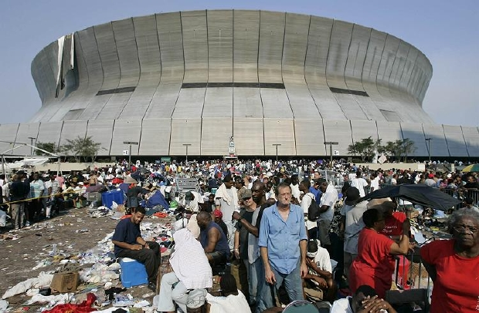
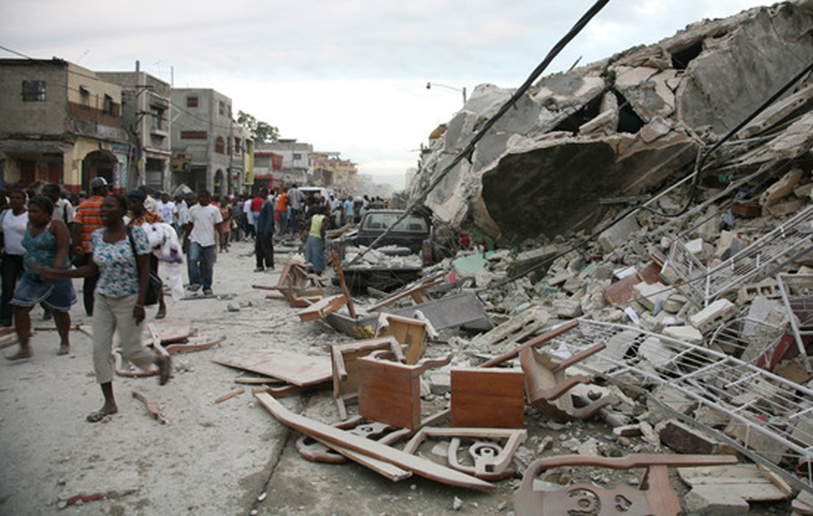
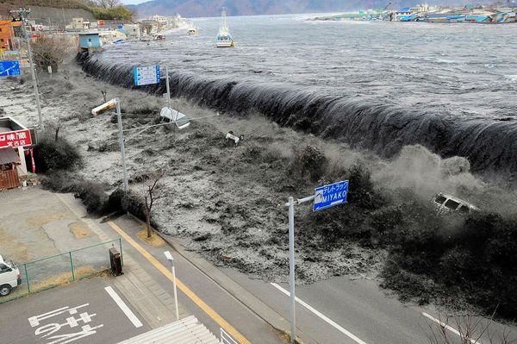
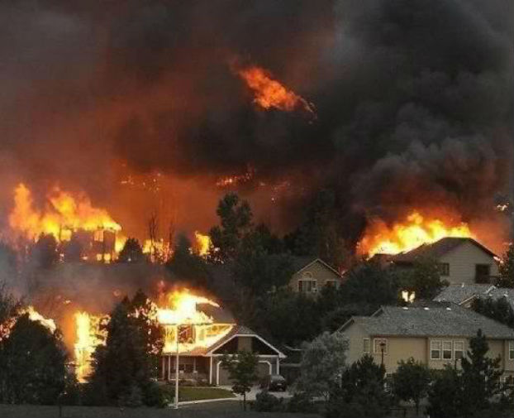
DISASTERS DO HAPPEN
Los Angeles Region | www.PrepareSoCal.org | www.RedCrossLA.org
Notes:
“As much as we don’t like to think about it, disasters do happen, right in our own backyard. These images come from some memorable and devastating events. Flooding from Hurricane Katrina, earthquakes in Chile, Japan and China, wildfires in California.”

Slide 3
THE 4 DISASTER DENIALS
1. It won’t happen to me… It won’t happen here
2. If it does happen here… it won’t be that bad
3. If it is that bad, there are people who will help me
4. It’s going to be so bad, it doesn’t matter what I do
Los Angeles Region | www.PrepareSoCal.org | www.RedCrossLA.org
Notes:
Script:
“Disasters DO happen, we know that, but even that knowledge does not motivate most people to take action. There are many reasons people don’t get prepared, but for the most part they break down into these 4 categories, odds are you have fit into or been a part of one of these groups at one point of another.”
Note to presenters: click and go through each one – do not spend much time just read aloud to the group.
Background info -
Preparedness barriers Denial
There are many reasons but they can be grouped this way:
Mark Benthien’s Group #1: the WBs (the Why Bothers) correlates with the textbook Denials (most often unconscious):
Denial #1: It won’t happen
Denial #2: If it does happen, it won’t affect me.
Denial #3: If it does happen and it does affect me, then it won’t be that bad. There are people who will help me.
Benthien’s Group #2: the DBs (the Don’t Bothers) correlates with the textbook Denials
Denial #4: If it does happen to me and it is that bad, there is nothing I could have done about it anyways.
We are 9-1-1 dependent, you hear people say that’s their plan – statistically the more affluent a community the more likely they are to rely on services of 9-1-1 to assist
They think someone is going to take care of them
In California - We live in paradise, which lulls us into a false sense of security, but SoCAL is as vulnerable to disaster as anywhere else in the world.
People's past experience and beliefs play a role
Immigrant communities – melting pot of cultures here all with different practices, experience in past disasters ex: lived through the 1933 Quake – I know what to do… well, a lot has changed since then – more structures, more people, more destruction, more dependency
Believe preparedness takes too much effort, is too expensive, is unachievable, unnecessary

Slide 4

PREPAREDNESS NOW
Los Angeles Region | www.PrepareSoCal.org | www.RedCrossStore.org
4
Notes:
“We’re going to try and play a quick 5 minute video for you. It can be a little intense for some, it’s based on a hypothetical but realistic scenario provided by the US Geological Survey. The most important part is that we can use this as a great teaching tool and following the video we’ll jump right into a few important steps that everyone can take to get prepared.
Here we go…”
NOTE for presenters: Video file needs to be saved in the same location as the presentation on your jump drive or laptop. Before the presentation you should open up the powerpoint and click on the slide to see if it plays or not. If the video file is located on your computer you can link the slide to the video file and play.
If the file does not play, do not waste time trying to fix it, apologize, and move on.
If you have internet access at the location you can play the video from YouTube: http://youtu.be/w9NtvuiVmw8
NOTE to Presenters: gauge the reaction of your audience to the video, do people look upset or ok? This would be a good time to gauge the audience, “How did that make you feel? Scared? Surprised? Nothing new?”
The reason we show the video is because it’s a great example of what could happen and gives us a place to start planning.

Slide 5
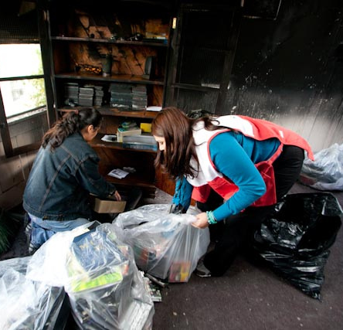
PREPARE OUR REGION
We live on the San Andreas fault
A fault zone composed of many active
faults that runs along 800 miles
Disasters occur everyday
The American Red Cross LA Region
responds to an average of two fires
a day each year
The “Big One” is coming
The US Geological Survey predicts our region will experience a major earthquake in the next 30 years
Los Angeles Region | www.PrepareSoCal.org | www.RedCrossLA.org
Notes:
“The Red Cross Los Angeles Region responds to an average of one residential fire a day. And, of course, L.A. is right on top of San Andreas Fault. It caused a 7.1 magnitude earthquake in 1989. The Northridge earthquake in 1994 happened on an entirely new fault line that we didn’t even know about. The U.S.G.S. predicts that we’ll have another big quake within the next thirty years. It’s really not a question of if a disaster will strike, but when.”

Slide 6
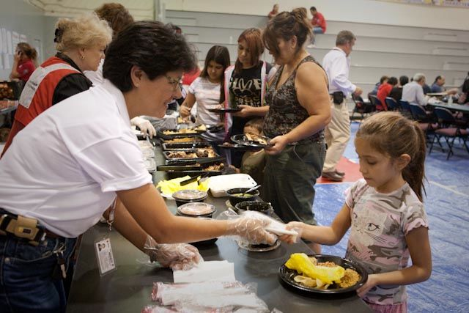
HAVE YOU PLANNED FOR
Delay in help
Power outages
Road closures
Property damage
Lack of clean water
Living in a shelter
Limited or no communication
Los Angeles Region | www.PrepareSoCal.org | www.RedCrossLA.org
Notes:
“After a big disaster, like the Northridge quake in 1994, the basic functions of a city are disrupted.
It may take some time before first responders can get to you. It is not that emergency responders don’t want to help you, but that they will be incredibly overwhelmed and may not be able to get to you. There will be hundreds of thousands of other people in need of assistance and the same road closures and power outages that affect you, will affect them as well. That’s why we recommend that you are able to take care of yourself for AT LEAST 72 HOURS.
You’ll probably be without power. No power means no gas pumps, no credit card machines, no television, no ATMs.
Phone lines will be down or jammed. Long distance lines are usually the first to be available, making it easier to call across the country than across the street.
Roads will be blocked or closed, making transportation difficult.
Your water pipes may be cracked, so you can’t get clean water into your home.
(if VIDEO played) Does anyone remember how much water the video recommended you have? ANSWER: 1 gallon/per person/per day for 3 days
We recommend that you be prepared to take care of yourself for a minimum of 3 days. The longer you are able to do so, the better off you will be.
The good news is…”

Slide 7
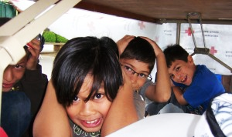
WE CAN BE READY
Los Angeles Region | www.PrepareSoCal.org | www.RedCrossLA.org
Notes:
“We don’t have to sit here, helpless, waiting for a disaster to strike. There are steps we can take right now to prepare ourselves for the worst
Just knowing that you’re prepared will help. You’ll be more likely to remain calm and respond properly in the event of a disaster, which reduces your risk of injury. Those who prepare are also more self-sufficient and recover much more quickly after a disaster.”

Slide 8
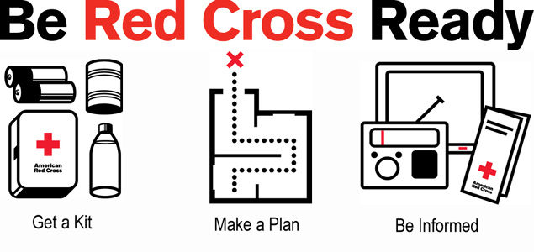
BE RED CROSS READY
Los Angeles Region | www.PrepareSoCal.org | www.RedCrossLA.org
Notes:
“There are three basic steps to being Red Cross Ready. Get a kit, make a plan, and be informed.”
“I am going to repeat these several times during the presentation because these 3 steps are incredibly important for getting you prepared”
Presenter REPEAT
“Get a kit, make a plan, and be informed.”

Slide 9

GET A KIT
EMERGENCY SUPPLIES (essential)
Water
Food
First Aid Kit
Medications
Los Angeles Region | www.PrepareSoCal.org | www.RedCrossLA.org
Notes:
“So, get a kit, what am I talking about?
The most important thing to have in your kit is water. We can’t survive without it. The average person needs a gallon of water per day, for drinking, cleaning and sanitation. Include your pets when planning, we recommend you count your pets as people and store a gallon of water per day for them as well.
Next you’ll want some food. Choose food that doesn’t need to be refrigerated and doesn’t need to be cooked. Good ideas are granola bars, nuts, and canned food. Be sure to choose pop top cans or include a can opener. (opening a can with a rock is fairly difficult) Also, include food that you enjoy and foods that you have tried before, this is not a good time to start experimenting, you could be allergic or it could make you sick.
Include a first aid kit. Before packing it, open it up and see what you have inside. Also include any medication you take, both prescriptions and over-the-counter. You can ask your doctor for a few days’ worth of samples of your prescriptions to keep in your kit.”
These are the most vital supplies to keep in your kit. Work on getting them first. Then, we also recommend having these items…”

Slide 10
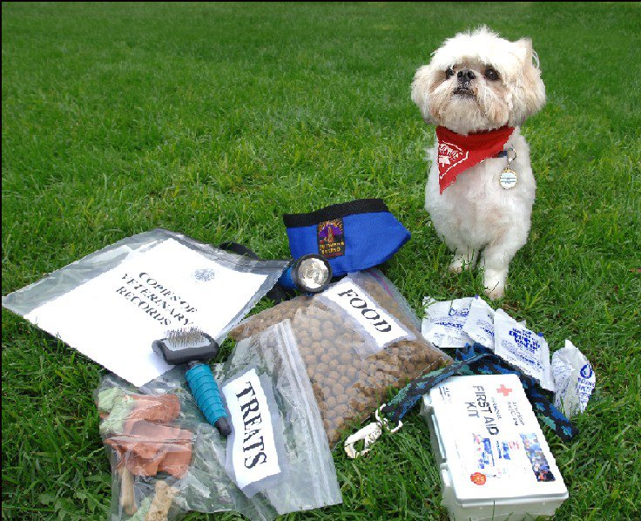
GET A KIT
EMERGENCY SUPPLIES (recommended)
Flashlight
Radio
Batteries
Cash
Contact information
Important papers
Pet supplies
Los Angeles Region | www.PrepareSoCal.org | www.RedCrossLA.org
Notes:
“You should also include a flashlight and a radio, and extra batteries for both. There are all-in-one flashlight and radio combinations, which are hand-cranked/solar powered and can charge a cell phone.
Make copies of your important papers, such as your driver’s license, insurance information and a photo copy of a utility bill. Response agencies like FEMA and the Red Cross can use a copy of a utility bill to help you get access to services. Make a list of contact information for everyone in your family, plus other people you might want to reach, like a doctor, emergency pet shelter and your out-of-state contact.
Include some cash in your kit, anywhere from $20 to $200. If the power is out, ATMs and credit card machines won’t work. Keep small denominations, plus some change in case you need to use a pay phone.
If you have pets, include supplies for them: food, water, cat litter, and a leash or carrier. You can probably think of other things which might be useful, like work gloves or hand wipes, but start with the essentials and work from there.”

Slide 11
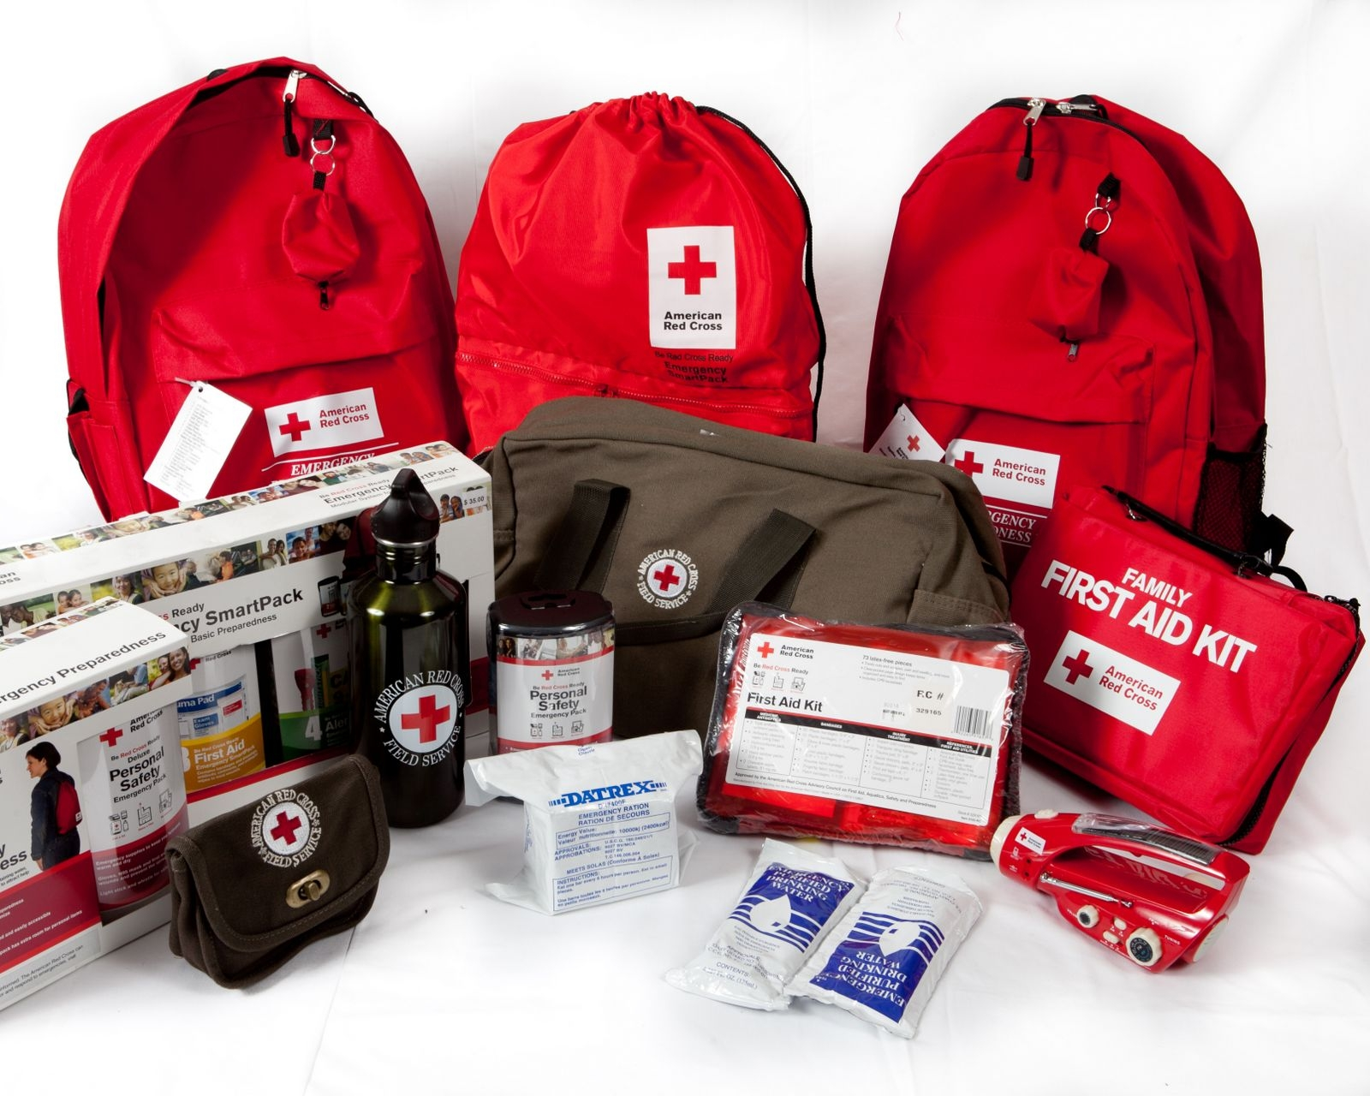
GET A KIT
PERSONAL KIT
Sturdy container or backpack
Easy to grab and go
3 days of supplies
for each person
Should be updated at least twice a year
Keep a kit: at home, at work, and in your car
Los Angeles Region | www.PrepareSoCal.org | www.RedCrossLA.org
Notes:
“One type of kit we recommend you have is a personal kit, with three days of supplies for one person. First, choose a sturdy container. We recommend a backpack, so you can throw it on and still have your hands free. Store three days of supplies for yourself, we call this a “grab and go” kit because if you have to evacuate your home, this is what you would grab on the way out. Keep it by the door you’d be likely to use in an emergency.
You should also keep personal kits at work and in your car. You never know where you’ll be during a disaster.”

Slide 12
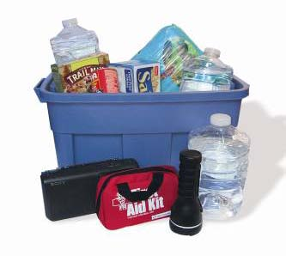
GET A KIT
FAMILY SUPPLY KIT (sheltering in place)
2 weeks of supplies
Change of clothes
Hygiene items
Toys and games
Books and magazines
Los Angeles Region | www.PrepareSoCal.org | www.RedCrossLA.org
Notes:
“If you’re able to stay in your home after a disaster, you’ll want a family supply kit with everything your family needs for two weeks. In addition to the items you keep in your personal kit, like flashlights and batteries, include a change of clothes for each person. You’ll want some hygiene items, like deodorant and toothpaste and comfort items for adults and children like toys, games, a deck of cards or books.
Be sure to account for the special diets or special needs of everyone in your household. If anyone wears contact lenses, store an extra pair and some saline.
Check the supplies in your kit twice a year. Replace any food or medicine near its expiration.
I know it sounds like a lot of stuff to get, but you can start with what you already have, like an extra can of food from your pantry. Pick up another item or two every time every time you’re at the store and you’ll gradually build up your kit. If you prefer, you can buy a preassembled kit from the red cross store online however, whichever you choose make sure to personalize it to fit your needs.”

Slide 13
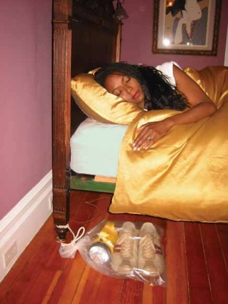
GET A KIT
BY THE BED KIT
Sturdy shoes
Flashlight
Prescription Eyeglasses (if needed)
Avoid stepping on glass and other debris post-earthquake
Los Angeles Region | www.PrepareSoCal.org | www.RedCrossLA.org
Notes:
“You should also keep a “by-the-bed-kit” tied to your bedpost. Imagine that a quake hits in the middle of the night and wakes you up. Anyone who was here for Northridge remembers it hit in the early morning hours. It will be dark, there could be broken glass or debris on the floor, and you’ll have bare feet. To get prepared, take a sturdy pair of shoes, a flashlight and an extra pair of glasses if you wear them, and put them in a bag. Then tie the bag to the base of your bed, so if the room shakes and the bed moves, you can still find it”
Note for presenters: This is the end of the “get a kit” section. Presenters can take questions about kits here, or wait until the end of the presentation to take all questions. Gauge the amount of time you have left, if running short, hold questions to the end.

Slide 14
BE RED CROSS READY
Los Angeles Region | www.PrepareSoCal.org | www.RedCrossLA.org
Notes:
“Here are our 3 steps again. Get a kit, make a plan, and be informed.
We’ve talked about emergency kits. Let’s move on to the next step in getting prepared…Make a Plan”

Slide 15
MAKE A PLAN
STEP 1: TALK
Talk to family, neighbors, and co-workers
Discuss your risks and vulnerabilities
Do you live in a high rise building?
Is someone you live with disabled?
Assign roles
Who will grab the emergency kit?
Who’s in charge of the children or pets?
Los Angeles Region | www.PrepareSoCal.org | www.RedCrossLA.org
Notes:
“The first step is to talk. Discuss with your family, including your kids. Ask, “what would we do?” this doesn’t have to be a scary conversation. Stay focused on what you can do to get ready. Kids are more scared by what isn’t talked about and what they don’t understand. They also take their cues from adults, if you tell them to look both ways before crossing the street, you should also tell them what to do in an earthquake.
Talk to friends, neighbors and co-workers. Work together to decide how you should respond to a fire, earthquake or flood. What if you’re at home? What if you’re separated? Is anyone in your home disabled or have access and functional needs?
Assign each person a specific role, such as grabbing the emergency kit or putting a leash on the dog. It prevents a duplication of efforts and everyone feels better if they have something to do.”

Slide 16
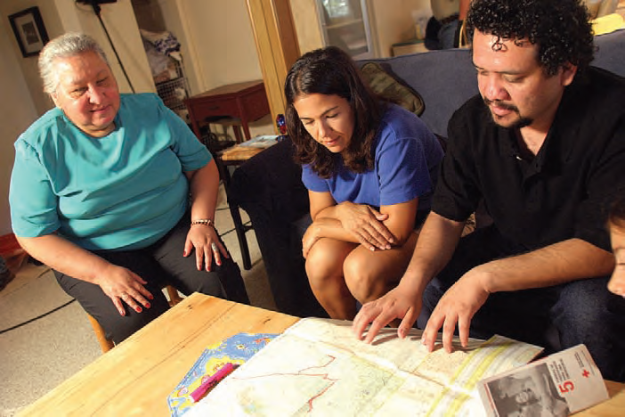
MAKE A PLAN
STEP 2: PLAN
Out-of-state contact
Two evacuation routes
Two places to meet
Plan for pets
Consider what to do if you are at home or away during a disaster
Los Angeles Region | www.PrepareSoCal.org | www.RedCrossLA.org
Notes:
“Develop your emergency plan by first choosing an out-of-state contact. Remember that after a disaster, phone lines will probably be down and it may not be possible to make a local call. Long distance lines are typically the first to be restored. If you and your family are separated, you may not be able to reach others, but you should all be able to call “Aunt Sally in Arizona”, and say “I’m here, I’m okay.” Make sure to ask permission, and then give everyone in your disaster plan that number to memorize and include in your kits.
Find at least two evacuation routes out of your home office, or school. Your main route may be blocked or dangerous, so have a back up. If you’re bedroom is above the first floor, get an aluminum fire escape ladder.
Choose two places to meet. One should be near your house, maybe on the nearest street corner, if you have to meet up outside. Your second meeting place should be outside your neighborhood, in case a larger disaster affects the whole area. You can meet at a post office, or your kids’ school.
If you have pets, include them in your plan. Red Cross shelters can’t accept pets other than service animals. If you’re displaced from your home, you’ll need somewhere else for them to stay. Do some research now to find a kennel pet friendly hotel.”

Slide 17
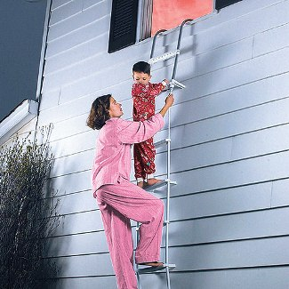
MAKE A PLAN
STEP 3: PRACTICE
Two times each year
Earthquake drills
Fire drills
Review supplies
Test smoke detectors
Include pets in drills
Register for CA drill: ShakeOut.org
Los Angeles Region | www.PrepareSoCal.org | www.RedCrossLA.org
Notes:
“The Red Cross recommends you practice your emergency plan twice a year, a good way to remember is to do it when you change your clocks. (optional joke: Spring forward, fall back, crawl out the window). Try evacuating through both of your escape routes and if an emergency ladder is part of your escape route, test it in your drills as well. Evacuate with your emergency kits and your pets, just as you would in a real disaster. You don’t want to be doing any of this for the first time when you’re actually in danger.
When you practice your drills, it’s also a good time to review your kit for items nearing their expiration dates. You can make it fun, especially for children, by practicing your evacuation plan followed by a preparedness picnic at your meeting place with the provisions in your kit. Don’t forget to replace the provisions afterwards.
You should also test your smoke detectors once a month. I test mine almost every time I cook, they work, you can test yours by pushing the test button on the device, if the sound goes off, they work, if not, please change your batteries.
You can also register for the Shake Out Drill by visiting ShakeOut.org. Every year on the same day at the same time participants simulate a statewide earthquake and practice Drop, Cover and Hold on. Last year more than 3 million people participated.”

Slide 18
BE RED CROSS READY
Los Angeles Region | www.PrepareSoCal.org | www.RedCrossLA.org
Notes:
“Here they are again. Now that you’ve learned what you should put in an emergency supplies kit and what to include in your disaster plan, let’s talk about…being informed. As a matter of fact, you’re doing it right now!
Attending this presentation is a great step toward getting prepared. I encourage you to go further.”

Slide 19
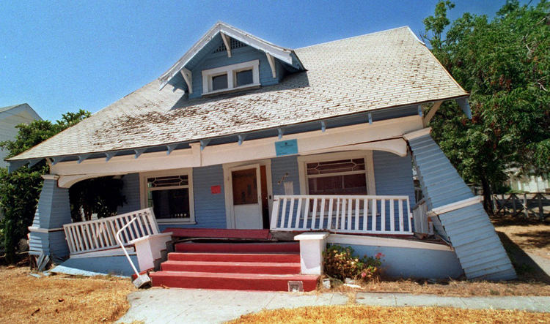
BE INFORMED
KNOW HOW TO RESPOND TO YOUR RISKS
Earthquakes
Home fires
Flooding
Wildfires
Pandemic flu
Tsunami s
Heat waves
Los Angeles Region | www.PrepareSoCal.org | www.RedCrossLA.org
Notes:
“In Los Angeles we are all particularly at risk for earthquakes. Everyone is also at risk for residential fires and pandemic flu. If you live near the coast, you may also be at risk for tsunamis, which can happen after an earthquake. If you live near a wilderness area, you may be in the path of wildfires. Do some online research or ask you neighbors to find out which disasters have affected your area in the past. Then you can learn which precautions to take.
Heat waves are actually one of the most dangerous risks. They cause more injuries than any other weather-related incident. Heat cramps and heat stroke are very serious and often sneak up on you. The initial feeling of a headache or stomach cramps can be indicators that you are suffering the effects of a heat exhaustion. If you or someone else seems to be affected, find a cool place to rest, some water and don’t exert yourself.”

Slide 20
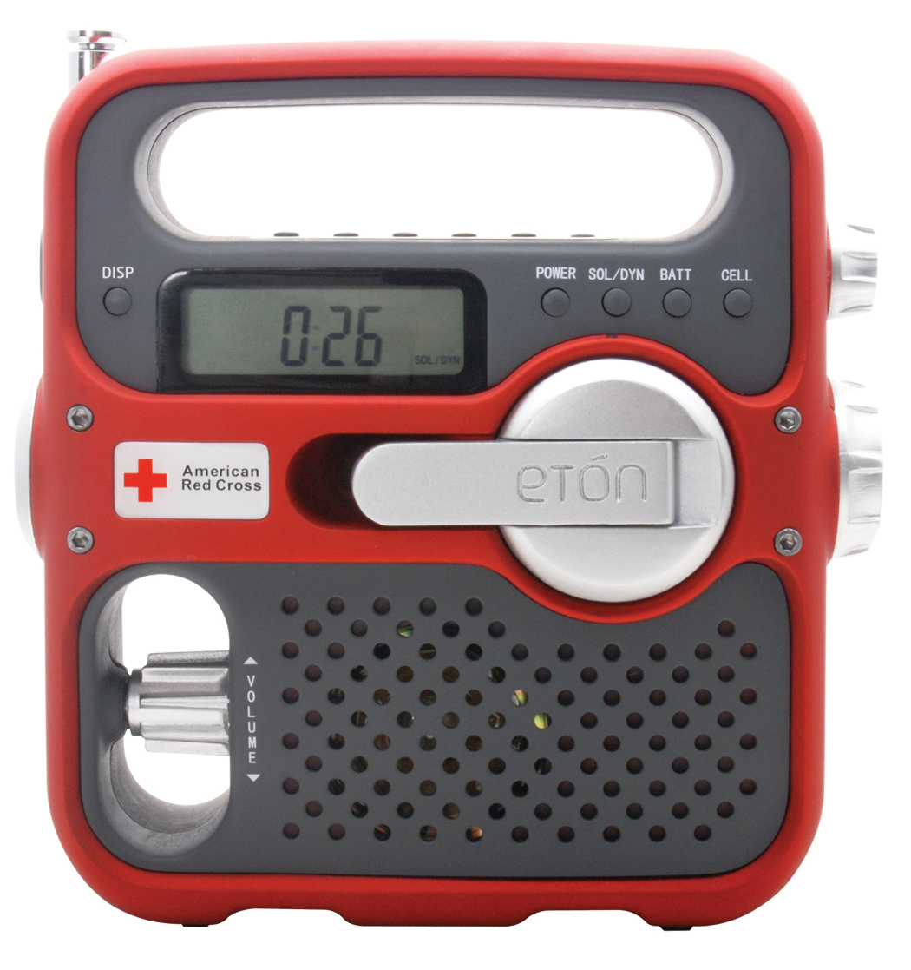
BE INFORMED
Radio stations
KNX 1070 am & KFI 640 am
Red Cross shelters broadcast on KNX1070
“Reverse 911”
www.alert.lacounty.gov
Register cell phones and email
Safe & Well:
redcross.org/safeandwell
Available online and in Red Cross shelters after a disaster
Los Angeles Region | www.PrepareSoCal.org | www.RedCrossLA.org
Notes:
“Know how local authorities will contact you in case of an emergency. In Los Angeles, the emergency Alert System will broadcast on KNX 1070 a.m. and KFI 640 a.m. The Red Cross will also use KNX 1070 to announce the locations of emergency shelters.
LA County also has a FREE “reverse 911” system. In case of a disaster, 911 will call you. Your landlines are already registered. If you want to get notifications on your cell phone or by email, you can also register them at alert.lacounty.gov. I have met parents that registered a cell phone to the zip code of their children’s school.
If you are ever notified to evacuate, please do so. There are always people who try to tough out a wildfire, flood, and they just end up having to be rescued. Give first responders a hand and get yourself out of harms way.
Safe and Well is a website designed to let family and friends know you are safe after a disaster. By registering you can search or be searched for by family and friends with a message and your status as of the disaster using a pre-disaster address or phone number and full name.”

Slide 21

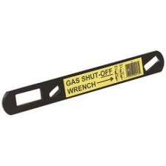
BE INFORMED
KNOW YOUR SURROUNDINGS
Conduct a “hazard hunt”
Items that may fall and break
Items that may block exits
Fire hazards (heating/kitchen)
Know how to shut off
Water
Electricity
Gas
Los Angeles Region | www.PrepareSoCal.org | www.RedCrossLA.org
Notes:
“Learn about your surroundings. Conduct a “hazard hunt” around your home to identify potential risks. You are looking for are items that could fall over during an earthquake. Is that tall bookcase going to block an emergency exit? Is your plasma screen TV secured to the wall? You can strap them to wall studs to keep them in place or move them to a safer location. Look for fire hazards, like frayed wires or overloaded electrical outlets and make them safe. People can take extra steps to secure their home. They can be sure their home is securely bolted to its foundations. Ask a professional contractor to verify this. Bolt water heaters and all gas appliances to wall studs. Secure bookcases and tall furniture to wall studs. Move heavy items to lower shelves. Never hang mirrors or pictures above the bed. Install latches in cabinets to keep them closed in case of shaking. Store hazardous or flammable chemicals in a closed cabinet, away from heat sources.
You should also know how to shut off your water, electricity and gas in an emergency. While the Red Cross recommends you practice almost everything, we DON’T recommend you practice turning off the gas because the Dept. of water & power or the gas company will have to come out to turn it back on. Just make sure you know where the shut off valve is located and keep the right kind of wrench nearby. The picture about is an example of one tool that works to shut off the gas. You can also use a crescent wrench. To turn off the value you usually find it in a parallel position to the gas line, use the wrench to turn the valve perpendicular. If you live in an apartment, ask your manager where the valve is.”

Slide 22

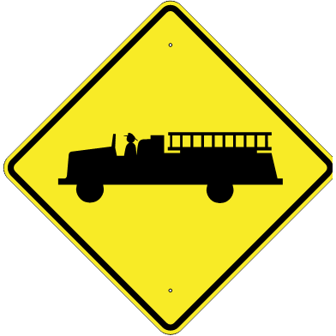

BE INFORMED
KNOW YOUR NEAREST
Police Station
Fire Station
Hospital
www.ReadyLA.org
Los Angeles Region | www.PrepareSoCal.org | www.RedCrossLA.org
Notes:
“If you’re like most people now, you rely very heavily on your phone or GPS to get most places. In a disaster and without those tools do you know where your nearest hospital, police and fire station are? Find out their non-emergency phone numbers and keep a list by your phone and in your emergency kit. You can go to ReadyLA.org to find your nearest services, the site is run by the City of Los Angeles Emergency Management Department and it’s a great tool to use.”

Slide 23
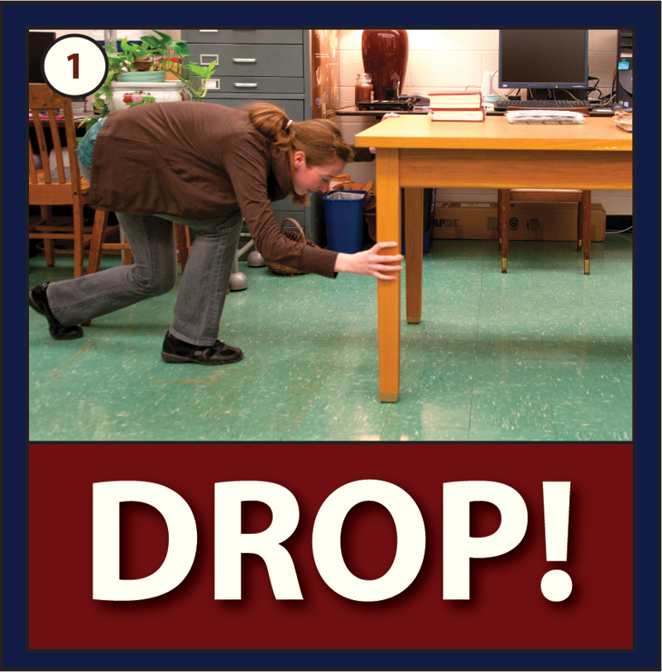
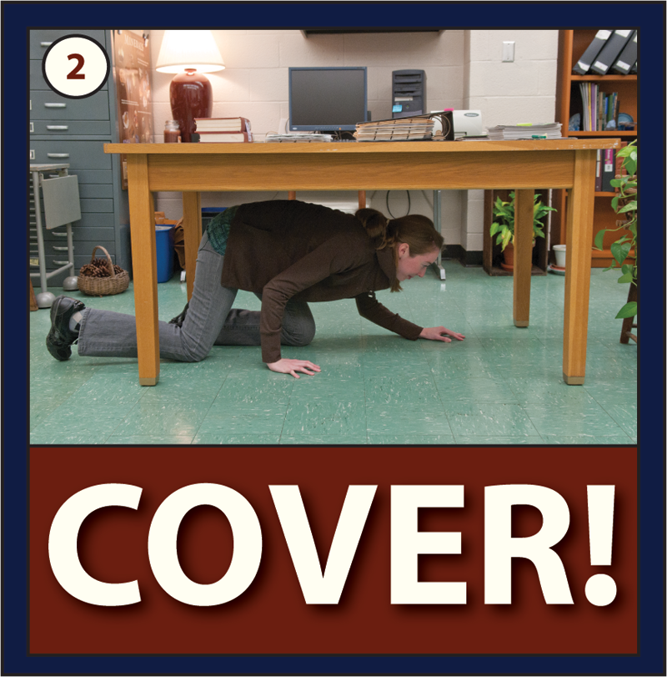
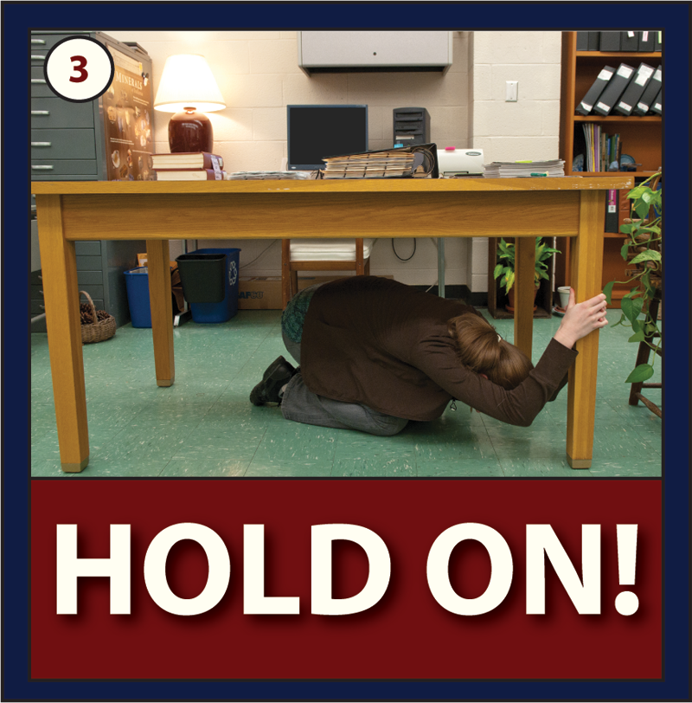
BE INFORMED
“WHAT SHOULD I DO DURING AN EARTHQUAKE?”
Los Angeles Region | www.PrepareSoCal.org | www.RedCrossLA.org
Notes:
“Has anyone ever heard of running for a doorway in an earthquake? (some people nod, raise their hands) That is something we can all remember being taught at one point or another. Doorframes are no safer than any other part of the house and even if you get to one, there is a door in it that could hit you or hurt your fingers.
The most important messages to convey about earthquakes are to “get a kit, make a plan and be informed” ahead of time, and to practice “drop, cover and hold on” in the case of a quake.
Drop- means drop where you are, if you can crawl to a sturdy piece of furniture, do so, but do NOT run for a doorway or run to an exit, you could injure yourself or others.
Cover- you want to cover your face and neck and protect yourself from flying objects.
Hold on- hold on to furniture, and move with it.”

Slide 24
BE INFORMED
WHAT IF SHAKING OCCURS WHILE I AM…
IN BED?
Cover head with pillow
Avoid flying objects
Safely evacuate when possible
IN MY CAR?
Pull over to the side
of the road
Stop and set the
parking brake
Stay inside vehicle
until shaking stops
Los Angeles Region | www.PrepareSoCal.org | www.RedCrossLA.org
Notes:
“If you are in bed when the shaking occurs, you’ve hopefully moved all those heavy objects you identified during your “hazard hunt” a few slides earlier, and you’ve made your bedroom as safe as possible. So you want to cover your face with a pillow [LIGHTLY] and avoid flying objects. Evacuate safely when possible.
If you are in your car, you want to pull over safely IF POSSIBLE, stop and set your parking break and stay inside the vehicle until the shaking stops. If you can’t get over to the side of the road, slow with traffic and come to a stop. Pull the parking break and STAY INSIDE THE VEHICLE. Some people will not respond appropriately and may drive faster or erratically, you do not want to get out on the highway and be hit by a car.
Avoid power lines, overhangs and underpasses if possible.”

Slide 25
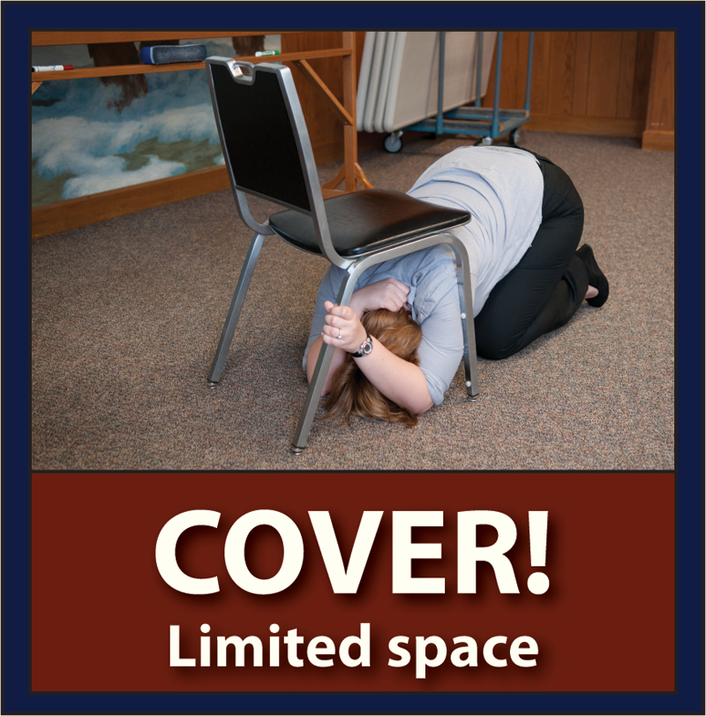
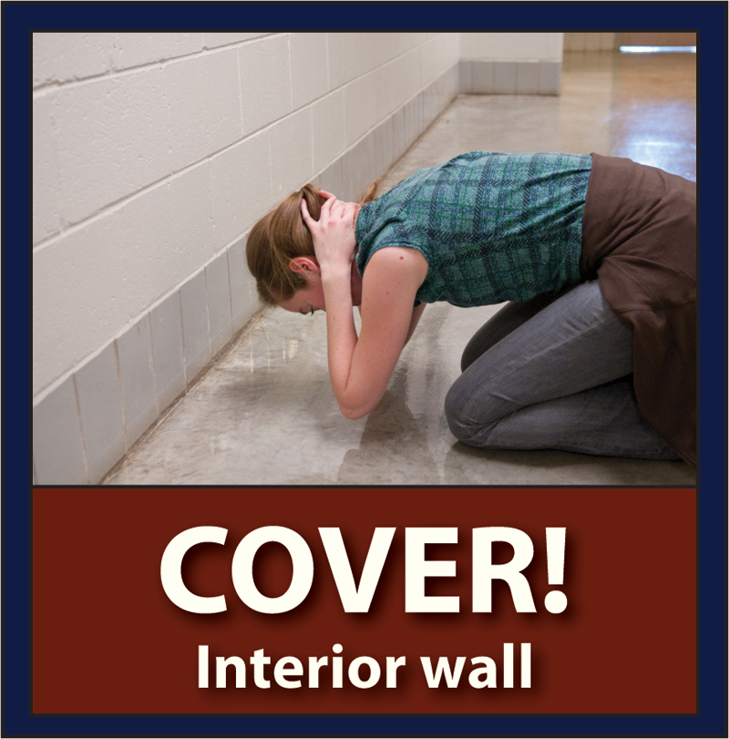
BE INFORMED
WHAT IF I CAN’T FIND COVER?
Cover as much as possible, especially your head and neck
Drop to the ground in an interior hallway
Stay clear of windows and doorways
Once shaking ends, carefully evacuate building
Los Angeles Region | www.PrepareSoCal.org | www.RedCrossLA.org
Notes:
If you can’t find cover you should
Drop to the ground near an interior wall
Stay clear of windows and exterior doorways
Cover as much as possible, especially your head and neck
Hold on until shaking stops
Once shaking ends, carefully evacuate building

Slide 26
BE INFORMED
Cooking equipment causes most home fires in the U.S.
You should only use an extinguisher if you have been trained to do so
Incidence and severity of fires increase during the winter holiday season
Pay close attention to candles and heating equipment
Los Angeles Region | www.PrepareSoCal.org | www.RedCrossLA.org
Notes:
“Everyone should have smoke detectors in their home. Install one outside each bedroom, and at least one on every floor. Have at least one fire extinguisher at home, and learn how to use it. You can contact the fire department to schedule a time to go an learn how to safely use an extinguisher. Consider installing an arc-fault circuit interrupter at the main electrical box to prevent electrical fires. Also consider a home fire sprinkler system. If there are bars on the windows and doors, be sure to install a quick-release on the inside. Clean and maintain all home heating sources at least once a year. Space heaters should be certified safe by an independent laboratory. Unplug them anytime the home is empty.
The number one cause for home fires is unattended cooking in the kitchen, after that, space heaters, frayed wires, overloaded electrical outlets and candles left alone.”

Slide 27
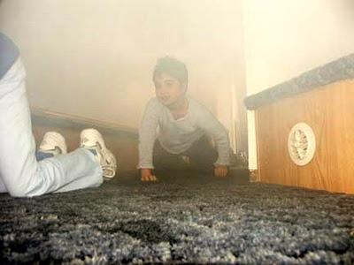
BE INFORMED
“WHAT SHOULD I DO DURING A FIRE?”
Feel door knob for heat with the back of your hand
Crawl low in smoke
Signal out window if you are trapped
Stop, Drop and Roll if you are on fire
GET OUT & STAY OUT!
Los Angeles Region | www.PrepareSoCal.org | www.RedCrossLA.org
Notes:
“ If you find yourself in a building that is on fire, get out and stay out. The hardest thing to say to groups, is this, don’t go back into a burning building for anything, not for property, not for pets, not even for other people. The first thing you should do when you get out safely is call 911 and get help on the way. If you go back into a building you don’t know the person was able to get out through another route and you can easily become another person that needs saving. You can help much more by serving as a point of information for trained emergency responders.
If you could not get out right away. Smoke rises, so you need to get low and crawl out. More people experience injuries from smoke inhalation than from flames. Crawl low to your nearest exit and briefly touch the door with the back of your hand. Do you know what your feeling for? (pause for answer: heat) Heat. If the door is hot, do not open it, fire is likely on the other side. Crawl to your other exit and test again.
If your second exit is blocked, stuff any additional cloth or material you have under doorways to keep smoke from getting in. Cover your mouth and nose with your shirt as well. Crawl to the window, open it, break it if you have to and signal out for help. Emergency responders are trained to recognize this as a signal, that you are trapped and need help.
If your clothes catch on fire, do not run, this will make the flames worse. You want to stop, drop and roll to smother the flames.”

Slide 28
Know the Difference!
BE INFORMED
“WHAT SHOULD I DO DURING A Flood?”
Flood Watch
Flooding or flash flooding is possible in your area
Stay tuned to news stations or NOAA Radio
Prepare to evacuate quickly
Flood Warning
Flooding or flash flooding is occurring or will occur in your area
Evacuate to higher ground immediately
Avoid flood waters while driving
Los Angeles Region | www.PrepareSoCal.org | www.RedCrossLA.org
Notes:
There are two different kinds of alerts surrounding flooding: a flood watch and a flood warning.
Flood watch means that flooding is possible in your area. While this may not occur, be prepared to evacuate at a moment’s notice and stay tuned to local news agencies.
Flood warning means that a flood is either currently occurring or is on its way. When you hear a flood warning, evacuate immediately to higher ground.

Slide 29
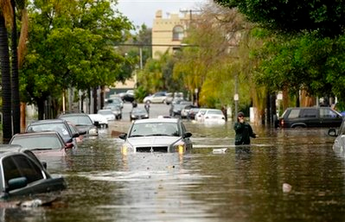
Responding to and Recovering from a Flood
During a Flood
Tune into a radio station or NOAA radio station
Evacuate to higher ground
Keep children away from water
Avoid flooded roads
Notes:
Once you have received a flood warning, it is important to evacuate to higher ground as soon as possible. Tune your car or portable radio to a NOAA radio station to get information about where and when flooding is occurring. Children may be curious and want to jump or play in flood waters. However, this water is often contaminated and can continue to rise. Keep children away from flood waters to protect them from disease or being swept away. While driving, avoid any flooded roads. You never know how deep the water is or if the water will continue to rise causing you to become stuck. Additionally, most cars can be swept away in less than two feet of moving water.

Slide 30
Responding to and Recovering from a Flood
After a Flood
Return home when officials have declared it is safe
Check home for damage
Check food and water for contamination
Watch out for animals that may have moved in
Notes:
After a flood, return home only after officials have determined that your home is safe. Before entering your home, check for any damage. This may include structural damage and damage to power and gas lines. If power lines are down by your home, do not step in any puddles and if you smell gas or hear hissing, call the fire department. If you have a porch, check it for soundness before walking onto it. Once in your home, check for any additional damage. Look in your refrigerator and pantry for any water damage. Throw away any food or water that may have been contaminated by the flood. Never use contaminated water for cooking or cleaning. Your local authorities will be able to provide more information on water purification techniques. Flooding can bring unwanted visitors into homes. Watch out for any animals that may have moved in, especially snakes.

Slide 31
Flood Preparedness Resources
Flood Preparedness Information
www.redcross.org/pepare
www.ready.gov
LA City and LA County Resources
www.lacounty.gov/elnino
www.ElNinoLA.com
Notes:
The first two websites are good locations to learn more details on flood preparedness.
The last two websites are good websites to learn what the city and county of Los Angeles are doing to prepare for El Nino.

Slide 32
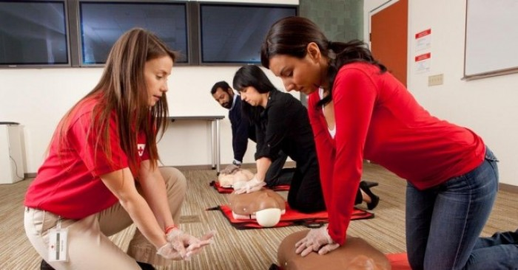
BE INFORMED
PrepareSoCal Campaign
www.preparesocal.org
CPR & First Aid Training
1-800-RED-CROSS
Map Your Neighborhood (MYN)
www.emd.wa.gov/myn
CERT: Community Emergency Response Team Citizencorps.gov/cert
Los Angeles Region | www.PrepareSoCal.org | www.RedCrossLA.org
Notes:
“So, you’ve learned how to make your home safer, what to do in an earthquake and in a fire. These are all important things to know, but definitely not an exhaustive list. We have plenty of other resources that could help you get ready and I’ll take you through a few of them now.
PrepareSoCal — a public awareness campaign to create more resilient communities that are better equipped to help each other prevent, prepare for and respond to life-threatening disasters. www.PrepareSoCal.org is a great site with plenty of tools you can utilize.
We highly recommend at least 1 if not 2 members in your family take a CPR/First Aid class. You never know who might need help. You can sign up by calling: 1-800-RED-CROSS to find a class near you.
Has anyone heard of CERT? The Community Emergency Response Team (CERT) is a program run by the Fire department that trains groups on how to work together and respond in a disaster. They cover light first aid, triage and search and rescue and at the end they light a fire and let you put it out with an extinguisher. For more information go to http://www.citizencorps.gov/cert”

Slide 33
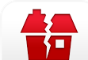
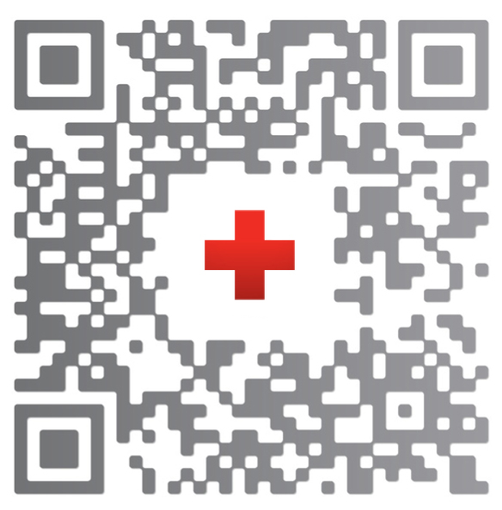

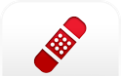
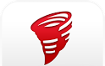
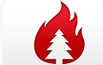

BE INFORMED
Earthquake? Bee sting? There’s an app for that! Available for iPhone & Android
Earthquake
Hurricane
First Aid
Tornado
Wildfire
Los Angeles Region | www.PrepareSoCal.org | www.RedCrossLA.org
Notes:
“If the internet is not working, features on your First Aid app will still work – checklists and important steps are still available, the emergency call feature most likely will NOT work – you can download this app to iPads and iTouch as well – but once again without internet connection or phone plan the call feature will not work on either of those devices.
Our Shelter View app is reliant on an online database and will most likely not work without the internet/for RED CROSS SHELTER locations you can always tune in your radio local emergency broadcasting. “

Slide 34
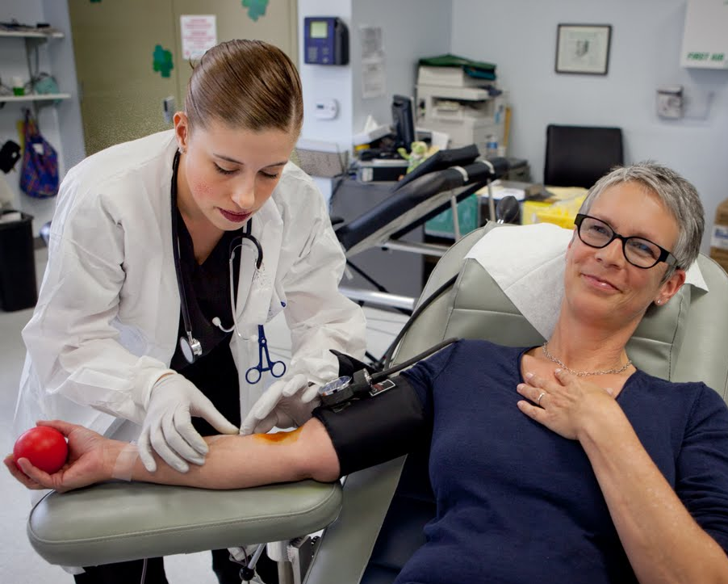
BE INFORMED
Ready Rating
www.ReadyRating.org
Volunteer
www.RedCrossLA.org
Give Blood
www.RedCrossBlood.org
1-800-RED-CROSS
Los Angeles Region | www.PrepareSoCal.org | www.RedCrossLA.org
Notes:
“Ready Rating (www.ReadyRating.org)
Ready Rating™ is a free, self-guided-program from the American Red Cross designed to boost emergency preparedness. Participants complete a 123-point self-assessment of their level of preparedness and have access to tools, tips and best practices to help improve their level of response to emergencies.
Becoming a Volunteer (www.RedCrossLA.org )
To become a volunteer you can visit www.redcrossla.org. The Red Cross is always looking for people to help us meet the mission. You can be trained to respond to families in need as a Disaster Action Team member, you can work in our office helping develop programs, you could be trained to give presentations like these.
How to Give Blood (http://redcrossla.org/blood/ )
If you don’t have time to volunteer, you could always give blood. It doesn’t take that long and you can now make appointments on line. It really doesn’t hurt that bad, you can save up to 3 lives with each donation and at the end they give you cookies and they tell you not to exercise.”

Slide 35
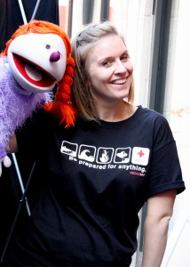
SPREAD THE WORD
OTHER AVAILABLE PREPAREDNESS SERVICES:
Prepare TEENS Jeopardy Game
PrepareYOUTH
Prepare KIDS Puppet Show
Request one of our free services:
www.RedCross.org/la-request
Los Angeles Region | www.PrepareSoCal.org | www.RedCrossStore.org
Notes:
“Help us spread the word – if you know of a group that could also use some preparedness training, our goal is to increase preparedness across the board, we have training for youth, adults and seniors. We train groups of 20 or more, we require a minimum 30 days notice. We do not present in personal residences, storefronts, restaurants or parking lots.”
Note to presenter: We have translated presentations in English, Spanish, Korean, Chinese, Farsi, Russian, French – we do have some trained presenters but it takes longer to schedule and staff for another language other than English/Spanish

Slide 36
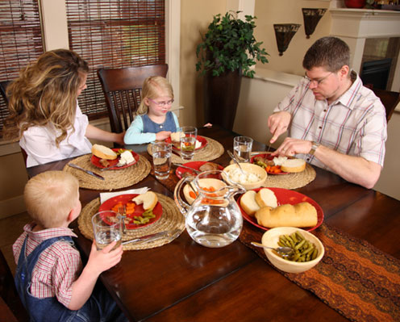
GET STARTED TODAY
Talk to your family at dinner
Find your gas shut-off
Create a by-the-bed kit
Download mobile apps
Please answer our 2 week follow up
We want to know, did you get prepared?
Los Angeles Region | www.PrepareSoCal.org | www.RedCrossStore.org
Notes:
“Every journey begins with a single step and you can get started today. When you go home tonight do one thing. Talk to your family, find your gas shut-off valve, create that by-the-bed kit and sleep peacefully knowing that you are one step closer to being disaster ready.
During the presentation/or when you first signed in, (depending on how you distributed the PS sheet- if you forgot this is a good reminder) you signed in using our PS Sheet. We will be following up with you within the next 2 weeks to send a VERY quick survey. It will ask how the presenter did and did you take any steps toward getting ready after taking this training, if you didn’t we also ask why, or how we can do a better job.
We REALLY appreciate your feedback, we honestly want to get as many people as we possibly can ready for a disaster and knowing how we did can lead to making important improvements, thank you so much in advance for your time and answers. I promise it wont take more than 2 minutes and all of your information is private and used only for this survey, the survey is anonymous and only asks for a zip code.”

Slide 37
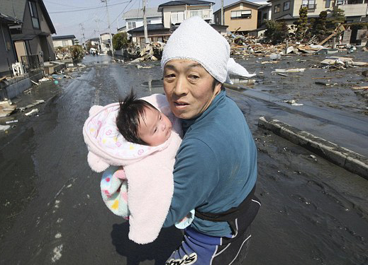
REMEMBER…
YOU and those around you are most likely to be the
FIRST RESPONDERS
Los Angeles Region | www.PrepareSoCal.org | www.RedCrossStore.org
Notes:
“It is the incredible acts of individuals, friends, neighbors and colleagues that can make the most difference in a disaster. At the Red Cross we are lucky to meet many amazing people in our line of work. The neighbor who opened up their home to others, a bystander who called 911 or delivered compression-only CPR, truly ordinary people who took action to help others. You are more likely to be helped by or to help the person next to you in a major disaster and we hope that after this presentation, you feel a little more empowered to do that.”

Slide 38
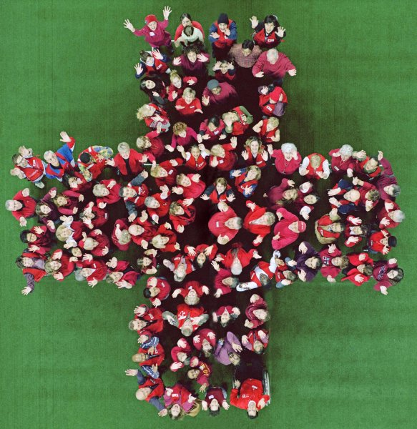
THANK YOU
Los Angeles Region | www.PrepareSoCal.org | www.RedCrossStore.org
Notes:
“Thank you so much for your attention. We really appreciate people taking the time to get prepared. If anyone belongs to other groups, or knows a group which might like a presentation like this, please let me know. Does anyone have questions?”
NOTE for presenters: The presenter can now address any further questions about preparedness, volunteering, or the Red Cross. The presenter does not need to know every answer to every question. If he or she doesn’t know, be honest and say so. The presenter can offer to find out the answer, then take contact information for the requester or for the person who organized the presentation to begin with. Then follow through, find out the answer and pass it along. As a Red Cross representative, the presenter should keep his or her promises to be helpful. The presenter can also direct the audience members to the website as a source of answers to any questions they may have in the future.
The presenter should now shut off the equipment and pack it up. Most of the audiences will leave. Some may stay to talk to the presenter, who should be receptive and polite. When finished packing up the equipment say goodbye to the organizer and head out. Be sure to collect the filled in PS sheets to take with you.

